Slide 1






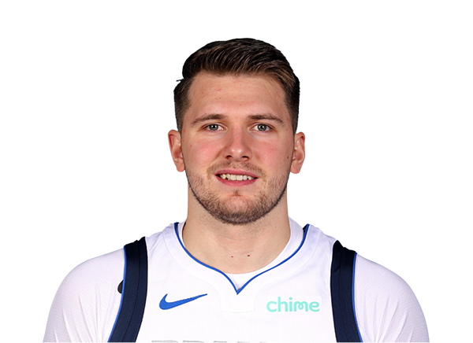






MY PERSONAL MVP RANKINGS
Rank | Player
1 | LeBron James (LAL)
2 | Nikola Jokic (DEN)
3 | Joel Embiid (PHI)
4 | Kawhi Leonard (LAC)
5 | Luka Doncic (DAL)
6 | Stephen Curry (GSW)
7 | Damian Lillard (POR)
8 | Donovan Mitchell (UTA)
9 | Giannis Antetokounmpo (MIL)
10 | Kevin Durant (BKN)
NBA STAT PADDER

Slide 2
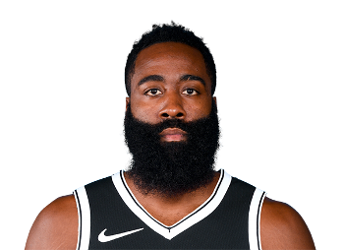

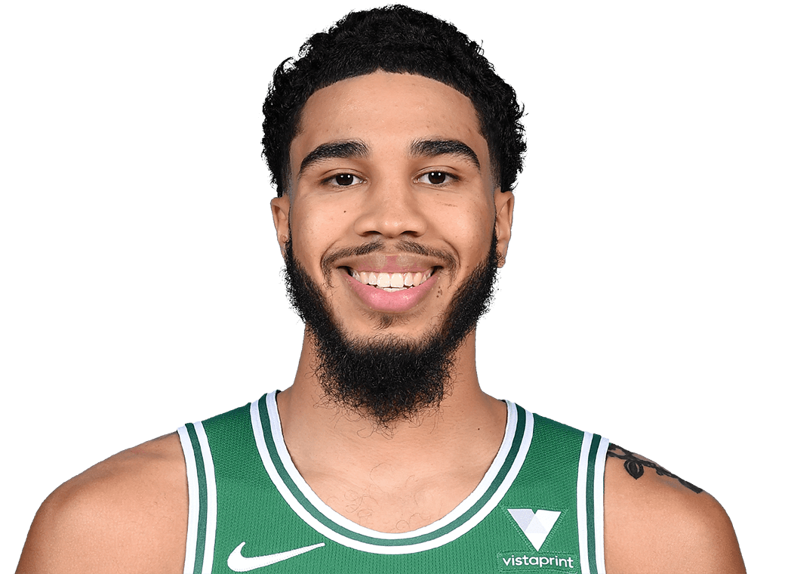
THROUGH JANUARY 24
Rank | Player | Score | % Chance to WIn
1 | Stephen Curry (GSW) | 144.21 | 20.83%
2 | Donovan Mitchell (UTA) | 129.42 | 18.70%
3 | Damian Lillard (POR) | 102.78 | 14.85%
4 | LeBron James (LAL) | 85.15 | 12.30%
5 | Nikola Jokic (DEN) | 62.67 | 9.05%
6 | James Harden (BKN) | 49.57 | 7.16%
7 | Paul George (LAC) | 47.77 | 6.90%
8 | Jayson Tatum (BOS) | 26.01 | 3.76%
9 | Luka Doncic (DAL) | 23.48 | 3.39%
10 | Kevin Durant (BKN) | 21.11 | 3.05%
NBA STAT PADDER

Slide 3
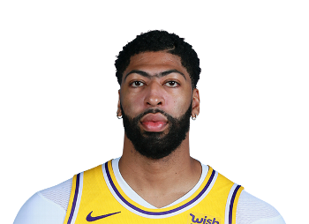
THROUGH FEBRUARY 17
Rank | Player | Score | % Chance to WIn | Rank Change
1 | Stephen Curry (GSW) | 235.62 | 32.93% | 0
2 | Damian Lillard (POR) | 167.48 | 23.41% | ↑1
3 | Donovan Mitchell (UTA) | 138.53 | 19.36% | ↓1
4 | LeBron James (LAL) | 54.06 | 7.56% | 0
5 | Kawhi Leonard (LAC) | 24.99 | 3.49% | ↑9
6 | Kevin Durant (BKN) | 23.78 | 3.32% | ↑4
7 | Joel Embiid (PHI) | 20.08 | 2.81% | ↑5
8 | Anthony Davis (LAL) | 18.40 | 2.57% | ↑7
9 | Luka Doncic (DAL) | 17.36 | 2.43% | 0
10 | Giannis Antetokounmpo (MIL) | 15.23 | 2.13% | ↑1
NBA STAT PADDER

